Slide 1
Lecture 2: Market Forces: Demand and Supply

Slide 2
Demand and Supply in Value Chain Agriculture

Slide 3
Demand
Demand is the quantity of goods or services that consumers are willing and able to buy at different price levels during a specific period.
It represents the desire of buyers to obtain products in the market.
Law of demand
Other things held equal (ceteris paribus), when the price of a good rises, the quantity demanded of that particular good falls and when the price of the good falls, the quantity demanded of the good rises.

Slide 4
Supply
Supply, on the other hand, refers to the quantity of goods or services that producers are willing and able to offer for sale at various price levels during a specific period.
Supply reflects the willingness of producers to make their products available to the market.
Law of supply
Other things equal (ceteris paribus), when the price of a good rises, the quantity supplied of the good rises and when the price of the good falls, the quantity supplied of the good falls.

Slide 5
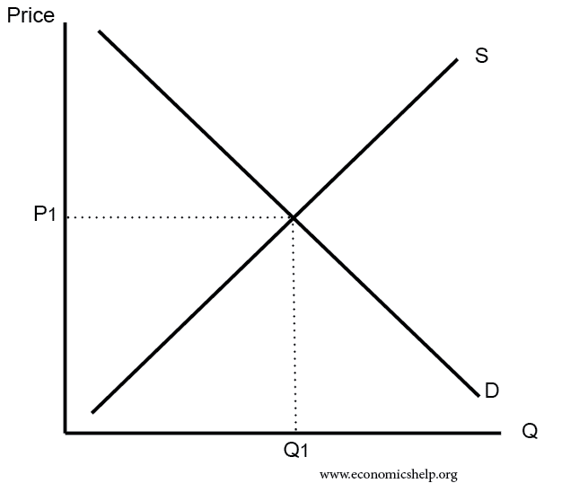
Diagram showing supply and demand schedule

Slide 6
Population:
An increase in population typically leads to higher demand for products.
Expectations:
Expectations of future price changes or income fluctuations can influence current demand. For example, if consumers anticipate higher prices in the future, they may increase their current demand.
Price of other goods
Substitutes- when the prices of substitutes of a good a rises, it leads to an increase in the quantity demanded of it’s close substitute.
Complements- when the prices of a good rises, the quantity demanded of its ‘perfect’ complement falls.

Slide 7
Factors Influencing Supply
Input Prices:
Changes in the prices of inputs like seeds, fertilizers, and labor can affect the cost of production, influencing the quantity of agricultural goods that producers are willing to supply
Technology:
Technological advancements in agriculture can increase productivity, leading to higher supply of agricultural products.
Government Policies:
Government policies, such as subsidies or trade regulations, can impact the cost of production and, consequently, the supply of agricultural goods.
Natural Conditions:
Weather conditions, pest outbreaks, and natural disasters can significantly influence the quantity of agricultural products available in the market.

Slide 8
Understanding Market Equilibrium

Slide 9
Market equilibrium is the point where the quantity demanded by consumers is equal to the quantity supplied by producers at a particular price level.
At this point, there is no surplus or shortage in the market.
When the price is too high (above the equilibrium), there is a surplus, leading to downward pressure on prices.
When the price is too low (below the equilibrium), there is a shortage, leading to upward pressure on prices.

Slide 10
Consumer Surplus and Producer Surplus
Consumer surplus refers to the economic benefit that consumers receive from purchasing a good or service at a price lower than the maximum price they were willing to pay.
In simpler terms, it represents the difference between the price a consumer actually pays and the highest price they would have been willing to pay.
Producer surplus, on the other hand, refers to the economic benefit that producers or firms receive from selling a good or service at a price higher than the minimum price they were willing to accept.
It represents the difference between the market price of a product and the lowest price a producer would have been willing to sell it for.

Slide 11
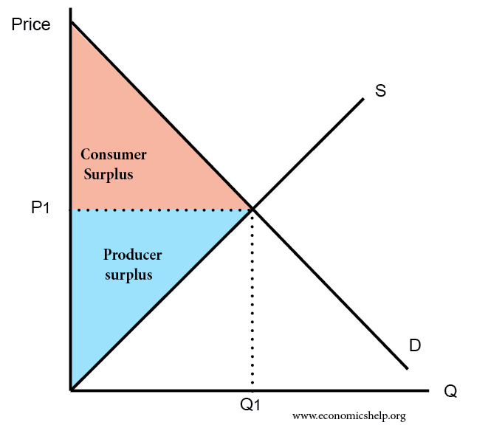
Graph showing Consumer and Producer Surplus

Slide 12
Consumer Surplus in Agriculture
Consumer surplus in agriculture refers to the benefit that consumers receive when purchasing agricultural products at a price lower than the maximum price they were willing to pay.
Consider a farmer's market selling fresh organic tomatoes. Suppose a consumer values a basket of organic tomatoes at MWK 200 because they highly appreciate the quality and health benefits of these tomatoes.
However, due to market competition or promotional discounts, the tomatoes are available for purchase at MWK 150.
In this case, the consumer surplus would be MWK 50 (MWK 200 – MWK 150), representing the extra value the consumer gains by acquiring the tomatoes at a price lower than their perceived worth.

Slide 13
Producer Surplus in Agriculture:
Producer surplus in agriculture refers to the benefit that farmers or agricultural producers receive when selling their products at a price higher than the minimum price they were willing to accept.
Consider a wheat farmer selling sacks of wheat in the market. Suppose the farmer incurs production costs and would be willing to sell a sack of wheat at MWK 80 to cover these costs and earn a reasonable profit.
However, due to the strong demand for high-quality wheat, the market price for a sack of wheat is MWK 120. In this scenario, the producer surplus would be MWK 40 (MWK 120 – MWK 80), reflecting the extra revenue or profit the farmer gains by selling the wheat at a price higher than their production cost or the minimum price they were willing to accept.

Slide 14
In both cases, consumer surplus and producer surplus play a crucial role in understanding the welfare and efficiency of agricultural markets.
Consumer surplus highlights the benefits that consumers enjoy when they can purchase products at prices lower than their valuation, while producer surplus emphasizes the benefits that farmers gain when they can sell their products at prices higher than their production costs.
These concepts help economists and policy makers evaluate market efficiency, welfare, and the overall economic impact of agricultural transactions.

Slide 15
Practical Examples of Demand and Supply in Agricultural Markets
Example 1:
Apple Market: During a bumper apple harvest, the supply of apples increases, leading to a surplus.
As a result, apple prices drop, and producers may find it challenging to sell their produce
Example 2:
Rice Market: If a government implements a subsidy program for rice farmers, the cost of production decreases, leading to an increase in the supply of rice in the market.

Slide 16
Implications of Demand and Supply in Agriculture
Understanding demand and supply helps value-chain agriculture students in:
Price Analysis: Analyze how changes in demand and supply affect agricultural prices and the income of producers
Market Strategies: Devise strategies to match production with consumer demand and maximize profits for farmers.
Policy Formulation: Evaluate the impact of government policies on agricultural markets and production.

Slide 17
Demand and supply are the driving forces behind agricultural markets. By comprehending these concepts, value chain agriculture students can better analyze market dynamics, make informed decisions, and address challenges in the agricultural sector.
As future professionals, mastering demand and supply will enable students to contribute significantly to the sustainable growth and development of value chain agriculture.

Slide 18
Exercise 1: Demand and Supply Analysis
Suppose the price of tomatoes in a local market increases due to a decrease in supply. What will be the likely impact on the quantity demanded by consumers? Explain your answer.
In a hypothetical scenario, the income of consumers in a rural area increases significantly. How will this change in income influence the demand for agricultural products in the region?
Draw a demand curve for oranges in a value chain agriculture market, indicating the relationship between price and quantity demanded. Explain the slope of the demand curve.

Slide 19
Exercise 2: Factors Influencing Supply
Analyze the impact of a drought on the supply of wheat in a value-chain agriculture market. How might farmers respond to the reduced supply?
Discuss how government policies, such as imposing export tariffs on agricultural products, can affect the supply of those products in the domestic market.
3. Provide examples of technological advancements in agriculture and explain how they can increase the supply of specific crops.

Slide 20
Case Study: The Impact of COVID-19 on the Poultry Industry
The poultry industry in Malawi faced significant challenges during the COVID-19 pandemic. Travel restrictions and lockdown measures disrupted the supply chain, affecting both producers and consumers.
Analyze the factors that influenced the demand for poultry products during the pandemic.
Discuss the supply-side challenges faced by poultry farmers during the COVID-19 crisis.
How did the disruption in demand and supply affect market equilibrium and poultry prices in the region?

Slide 21
The Market Equilibrium
In this session, we will explore the concept of market equilibrium and its significance in value-chain agriculture.
Market equilibrium represents the balance between demand and supply in a market, determining the price and quantity of goods exchanged.
Understanding market equilibrium is essential for value chain agriculture proffessionals as it helps in analyzing market dynamics and making informed decisions.

